Slide 1
Wireless Home Automation System
M. Waleed Hussain
Rameeza Rahim
Ariba Mumtaz

Slide 2
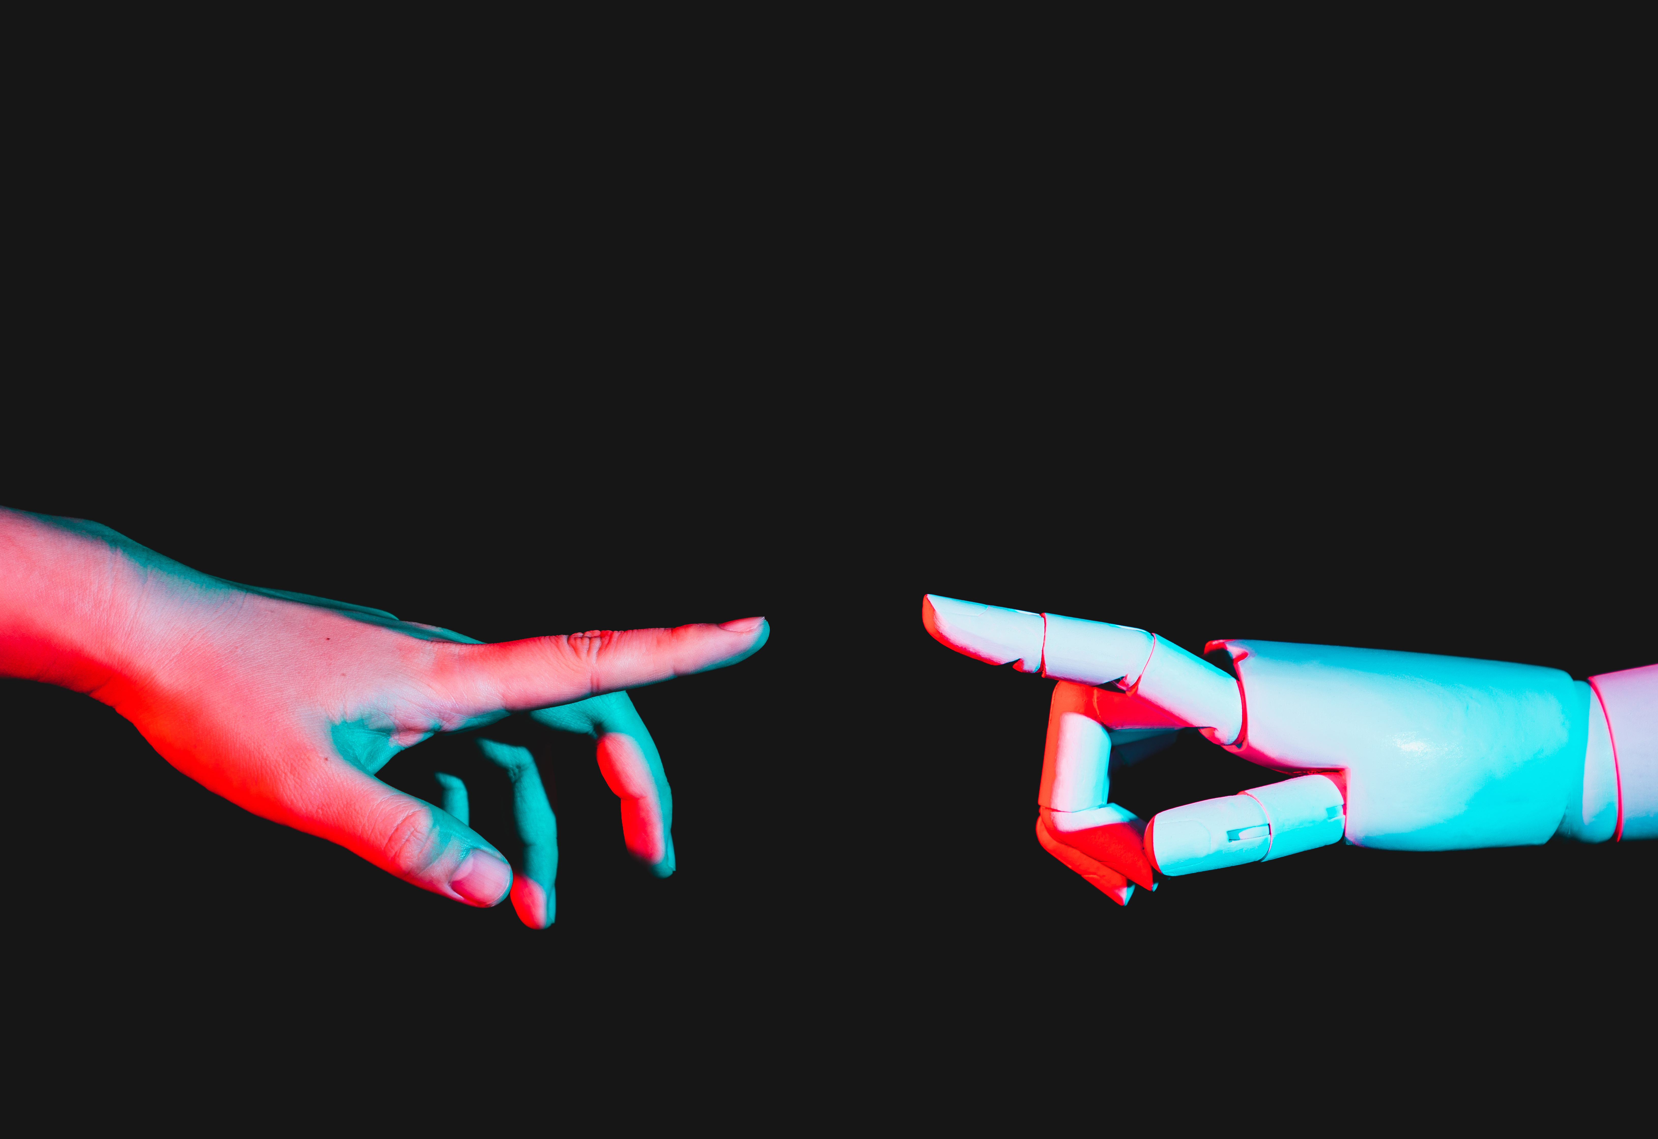
Agenda
About the Project
How MQTT is being used
Devices breakdown & interfaces being used
Resource links

Slide 3

Introduction
A wireless smart home automation system
Use MQTT as the communication protocol
Home Assistant as the automation platform
EMQX as the MQTT broker
3 Devices
Sensing device, control device and a smart bell

Slide 4
How MQTT is being used
Communication system

Slide 5
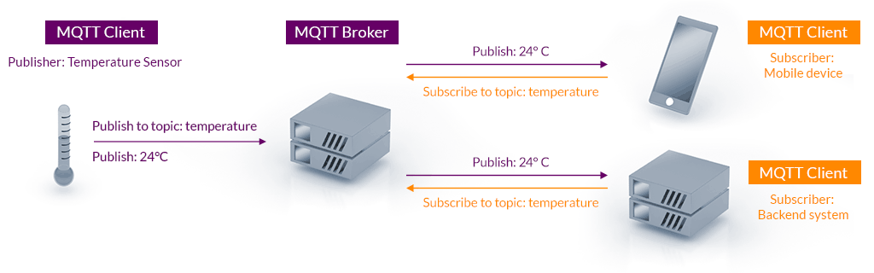
MQTT communication principle
Each client can have multiple topics
Multiple clients can subscribe to multiple topics
Each sensor, switch, actuator (entities) will have a state topic and a command topic

Slide 6
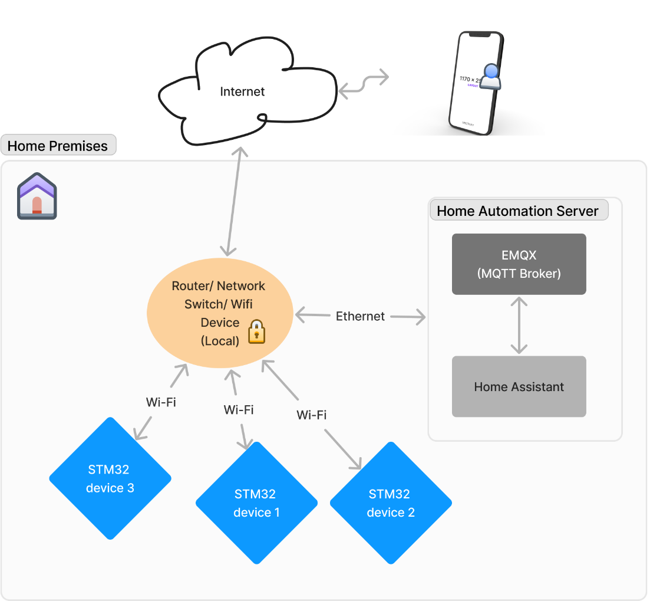
Our Implementation

Slide 7
Turn on
Connect to Wi-Fi
STM actions
Stabilize and establish communication with ESP01.
Read Sensors
Read sensor values
Connect to MQTT broker (EMQX)
Send high on gpio2 to tell stm32, ESP01 is on
Home Assistant Actions
Publish to pre-defined topics
Home-assistant picks up topic data
Send a discovery to ESP to send a command on Home Assistant Config Topic
Send acknowledgement to STM
Compares sensor values to preset triggers
If trigger is found, send command on appropriate devices topic

Slide 8
Devices Breakdown
Interfaces, peripherals and schematics

Slide 9
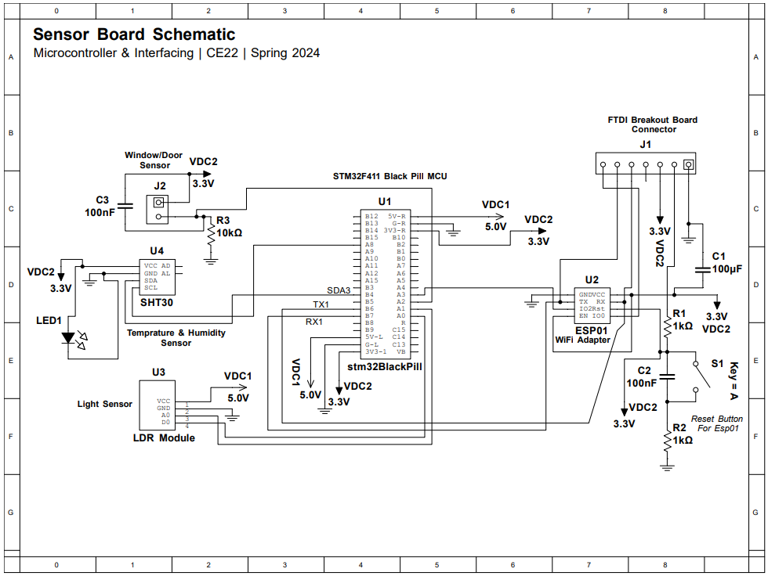
Device 1 | Sensing
Sensors used:
SHT30 temperature and humidity sensor
LDR module (Light sensor)
Window open and close magnetic switch sensor
Peripherals Used
UART
I2C
ADC
Digital Inputs and outputs

Slide 10
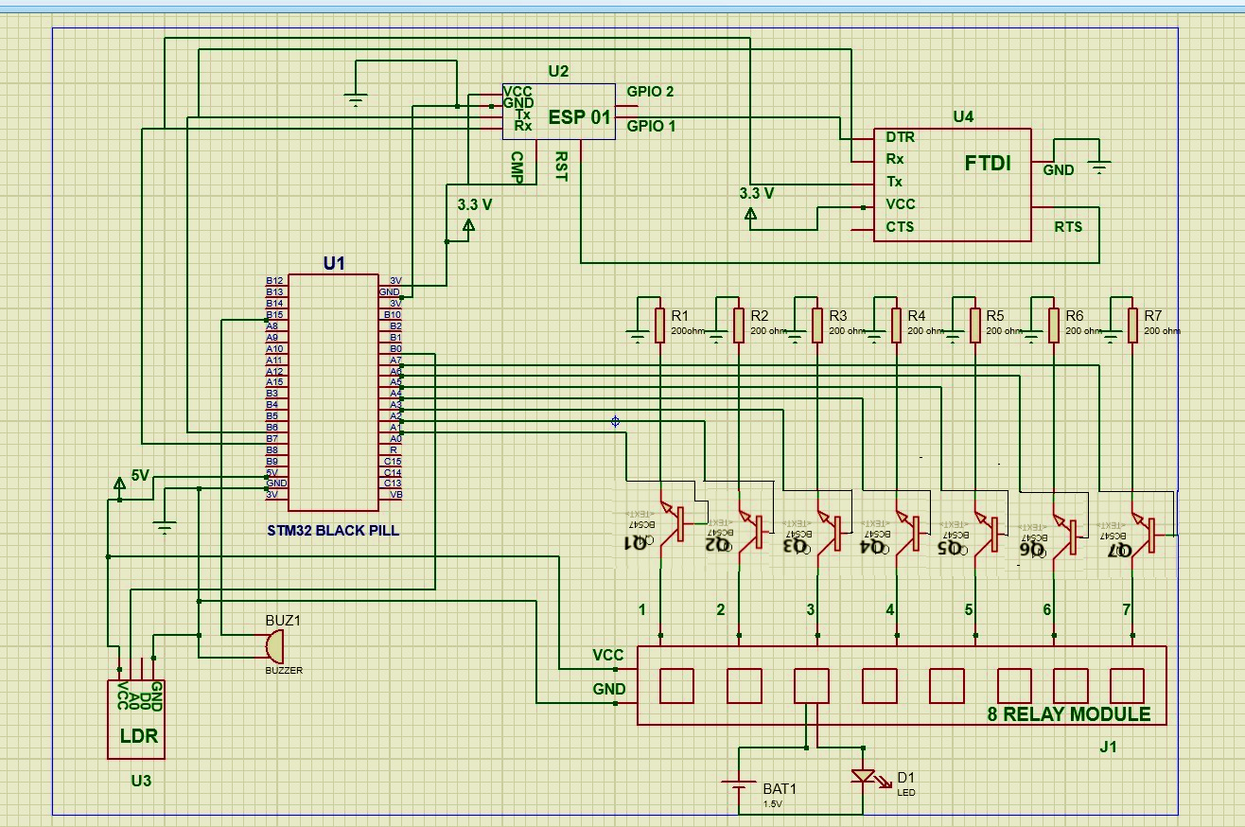
Device 2 | Control
Sensors used:
LDR module (Light sensor)
Actuators
8 Relay Channels (can be further connected to AC or DC devices)
Buzzer
ESP01
Peripherals Used
UART
ADC
Digital Inputs and outputs

Slide 11
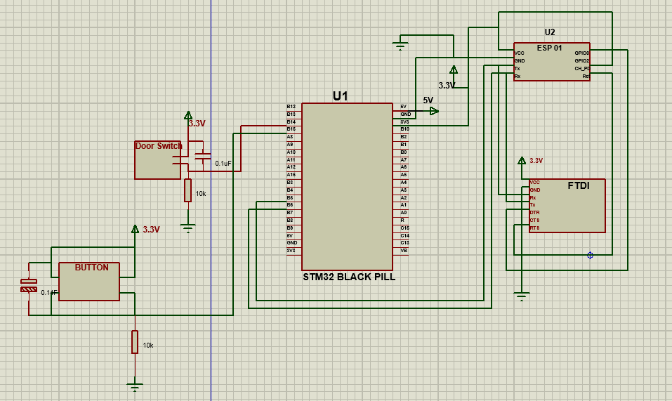
Device 3 | The Bell
Sensors used:
Bell Button Input
Door Sensor Switch Input
Peripherals Used
UART
Digital Inputs and outputs

Slide 12




Thank you
Reference Links
https://www.emqx.io/ (EMQX)
https://www.home-assistant.io/ (Home Assistant)
https://www.instructables.com/Getting-Started-With-the-ESP8266-ESP-01/ (getting started with esp01)
https://www.microchip.ua/wireless/esp01.pdf (ESP01 Datasheet)
https://www.mouser.com/pdfDocs/ProductOverview_DFRobot-DFRobot-STM32F411-BlackPill-Development-Board.pdf (STM32 Black Pill Datasheet)
Sample Arduino code for publishing devices using Home Assistant MQTT Discovery. See the following for use case: https://youtu.be/VHiCtZqllU8 or https://resinchemtech.blogspot.com/2023/12/mqtt-auto-discovery.html (github.com)

